Slide 1



Long Travel Bus Reservation
Group member
Nguyễn Sơn Trường
Nguyễn Lương Hải
Nguyễn Thị Bích Trâm
Nguyễn Ngọc Sơn
Supervisor
Kiều Trọng Khánh

Slide 2

Contents
Problem
Solution
Terms
Main Functions
Demo
Technologies
Summary

Slide 3
Problem
Average number of departures in a day in Mien Dong Bus Station ^{(*)}
*statistic in 2010 from http://www.benxemiendong.com.vn/

Slide 4



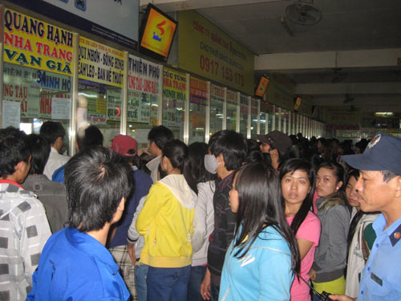
Problem
Customer
Staff
OVERLOADED!
Waiting for hours to buy tickets

Slide 5



Solution
Managing bus
Managing route
Scheduling
Booking tickets
Online payments
Long Travel Bus Reservation
Consult transaction history

Slide 6


Terms
Route and segments
Hà Nội
Hồ Chí Minh City
Đà Nẵng
Hải Phòng
Segment
Route
Route = Segment A + Segment B + …

Slide 7
Terms
Tariff
Hồ Chí Minh City
Đà Nẵng
200,000 VND
Hải Phòng
Segment | Fare | Valid date
Hồ Chí Minh City – Đà Nẵng | 200,000 VNĐ | 30/04/2013
Hồ Chí Minh City – Đà Nẵng | 250,000 VNĐ | 01/06/2013
From 0:00 30/04/2013 – 23:59 31/05/2013: 200,000 VNĐ
From 0:00 01/06/2013 – future: 250,000 VNĐ
Tariff = Segment + Fare + Time

Slide 8

Terms
Schedule and trip
Hồ Chí Minh City
Đà Nẵng
10:30 1/5/2013
03:30 2/5/2013
Hải Phòng
Trip
20:30 2/5/2013
Schedule
Schedule = Route + Bus + Time
Trip = Segment + Bus + Time

Slide 9
Terms
Journey and ticket
Hồ Chí Minh City
Đà Nẵng
10:30 1/5/2013
03:30 2/5/2013
Hải Phòng
Journey
20:30 2/5/2013
Journey
Journey = Start location + End location + Time
Ticket = Journey + Payment

Slide 10

Terms
Reservation
Hồ Chí Minh City
Đà Nẵng
Hải Phòng
Reservation = Ticket(s) + Booker’s Information

Slide 11


Main functions
Managing bus
Managing route
Staff
Scheduling

Slide 12
Main functions
Add new bus
Add new route
Update tariff
Assign bus to route
Create schedule
Customer can search journey and create reservation

Slide 13


Main functions
Booking
Online payment
Customer
Reservation history

Slide 14
Main functions
Search for journeys
Choose journeys
Choose seats
Input details
Pay with PayPal
Reservation is created. Customer can view reservation history

Slide 15
Demo
Staff
Customer

Slide 16
2 customers + 1 staff

Slide 17





Tools
Eclipse Indigo
Tomcat 6.0.26
MySql Server 5.5
Google Code
Tortoise SVN

Slide 18












Techniques

Slide 19
Summary
Achievement
Customer can book for tickets easily and choose the seats they want.
Customer can view their past reservations and status of them
Manage, scheduling for bus.
Payment with PayPal.
Limitation
Staff have to schedule for each journey.
Support only one online payment method.
Customer cannot change tickets or change seats in past reservation

Slide 20
Summary
Future Plan
Auto-schedule for each route, bus in a fixed time.
Integrate more online payment methods
Bảo Kim
Ngân Lượng
Support user to change tickets or seats.
Report for revenues

Slide 21
Thanks for your listening
Q&A

